Slide 1

ResAI Toolkit: Framework for Cross-Modality Bias Detection
24-25J-195

Slide 2
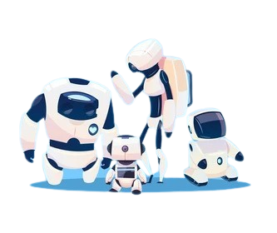
Team
K.M.S.P. Jayawardena.
H.M.I.K Dhanawardena.
E.M.A.M Ekanayake .
T. N. Mudalige.

Slide 3
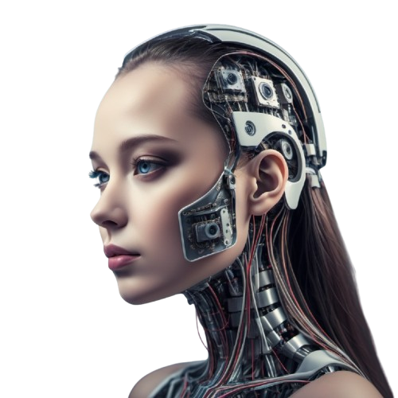
WHAT IS BIAS?
According to PWC it is a Situation where a model performs inconsistently across different demographic groups.
According to PWC there is four types of bias that is the cause of inconsistent performance across different groups in An Artificial Intelligence System.
Data bias.
Algorithmic Bias.
Prejudice Bias.
Exclusion Bias.
This research primarily focus on : Data bias with a focus on demography gender

Slide 4





Can Bias be Detected or Measured?
Existing Tools used for Bias Detection:
AI Fairness 360
Fairlearn
Google’s What-If Tool
TensorFlow Fairness Indicators
Metrics used by Existing Tools used for Bias Detection:
Demographic parity
Equalized odds.
Disparate Impact.
Average Odds difference

Slide 5

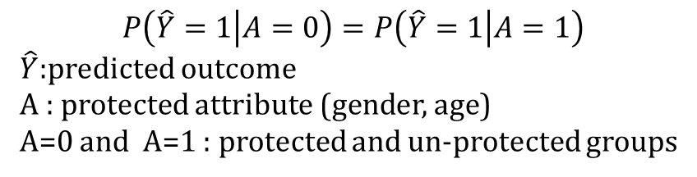
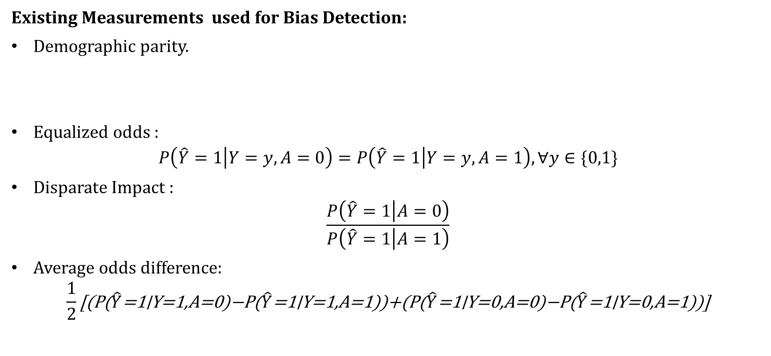
Can Bias be Detected or Measured?
Existing Measurements used for Bias Detection:
Demographic parity.
Equalized odds :
$$P\left(\hat{Y}=1 | Y=y,A=0\right)=P\left(\hat{Y}=1 | Y=y,A=1\right), ∀y∈\{0,1\}$$
Disparate Impact :
$$\frac{P\left(\hat{Y}=1 | A=0\right)}{P\left(\hat{Y}=1 | A=1\right)}$$
Average odds difference:
$$\frac{1}{2}\text{[(}\text{P}\text{(}\hat{Y}\text{=1∣}\text{Y}\text{=1,}\text{A}\text{=0)−}\text{P}\text{(}\hat{Y}\text{=1∣}\text{Y}\text{=1,}\text{A}\text{=1))+(}\text{P}\text{(}\hat{Y}\text{=1∣}\text{Y}\text{=0,}\text{A}\text{=0)−}\text{P}\text{(}\hat{Y}\text{=1∣}\text{Y}\text{=0,}\text{A}\text{=1))]}$$
$$P\left(\hat{Y}=1 | A=0\right)=P\left(\hat{Y}=1 | A=1\right)$$
$\hat{Y}$:predicted outcome
A : protected attribute (gender, age)
A=0 and A=1 : protected and un-protected groups

Slide 6

So what is the problem we are researching?
Existing Tools Focus on:
Mainly Structured Data.
Model performance and Outcomes .
What are we doing?
Create a Measure for the bias found in Text, Image, Audio and Video datasets used to build machine learning models.

Slide 7
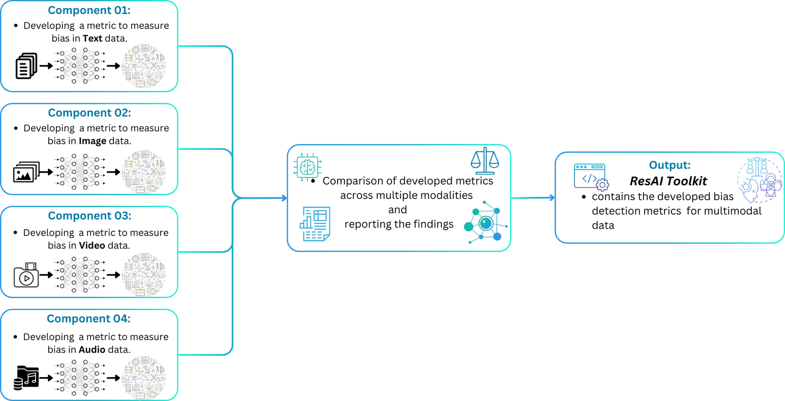
How does the ResAI Toolkit revolutionize AI bias detection?

Slide 8
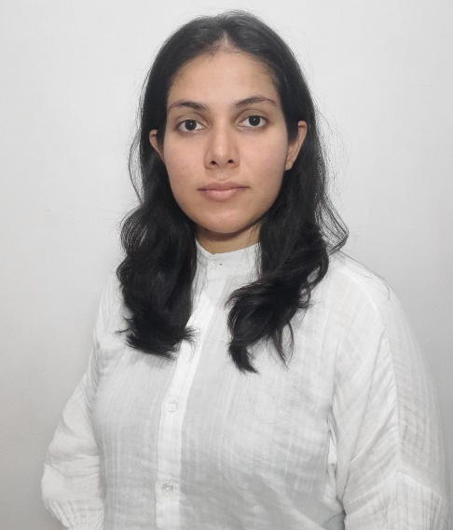
IT21380914 | K. M. S. P. JAYAWARDENA
Data Science
IT21380914 | K. M. S. P. Jayawardena | 24_25J_195

Slide 9

Developing a metrics for detecting Gender bias in RAW audio datasets used for model Building.
IT21380914 | K. M. S. P. Jayawardena | 24_25J_195

Slide 10
Existing metrics and Related works.
Character Error rate(CER): $\frac{Number of Incorectly predicted charcters}{Total number of characters in Reference text}∗100\%$
Character Error rate(CER): (𝑁𝑢𝑚𝑏𝑒𝑟 𝑜𝑓 𝐼𝑛𝑐𝑜𝑟𝑒𝑐𝑡𝑙𝑦 𝑝𝑟𝑒𝑑𝑖𝑐𝑡𝑒𝑑 𝑐ℎ𝑎𝑟𝑐𝑡𝑒𝑟𝑠)/(𝑇𝑜𝑡𝑎𝑙 𝑛𝑢𝑚𝑏𝑒𝑟 𝑜𝑓 𝑐ℎ𝑎𝑟𝑎𝑐𝑡𝑒𝑟𝑠 𝑖𝑛 𝑅𝑒𝑓𝑒𝑟𝑒𝑛𝑐𝑒 𝑡𝑒𝑥𝑡)∗100%
J. Meyer, L. Rauchenstein, J. D. Eisenberg, N. Howell, 2020 , “Artie Bias Corpus: An Open Dataset for Detecting Demographic Bias in Speech Applications”.
Word Error rate(WER): $\frac{Number of Incorectly predicted Words}{Total number of Words in Reference text}∗100\%$
Word Error rate(WER): (𝑁𝑢𝑚𝑏𝑒𝑟 𝑜𝑓 𝐼𝑛𝑐𝑜𝑟𝑒𝑐𝑡𝑙𝑦 𝑝𝑟𝑒𝑑𝑖𝑐𝑡𝑒𝑑 𝑊𝑜𝑟𝑑𝑠)/(𝑇𝑜𝑡𝑎𝑙 𝑛𝑢𝑚𝑏𝑒𝑟 𝑜𝑓 𝑊𝑜𝑟𝑑𝑠 𝑖𝑛 𝑅𝑒𝑓𝑒𝑟𝑒𝑛𝑐𝑒 𝑡𝑒𝑥𝑡)∗100%
S. Feng, O. Kudina, B. M. Halpern and O. Scharenborg, 2021 , “Quantifying Bias in Automatic Speech Recognition”.
M. Z. Boito, L. Besacier, N. Tomashenko, Y. Est`eve, 2022 , “A Study of Gender Impact in Self-supervised Models for Speech-to-Text Systems” .
Tanvina Patel and Odette Scharenborg, 2023 , “Using Data Augmentations and VTLN to Reduce Bias in Dutch End-to-EndSpeech Recognition Systems” .
IT21380914 | K. M. S. P. Jayawardena | 24_25J_195

Slide 11
Existing metrics and Related works.
Class Imbalance
C. Sekkat, F. Leroy, S. Mdhaffar & et al., 2024 , “Sonos Voice Control Bias Assessment Dataset: A Methodology for Demographic Bias Assessment in Voice Assistants ”.
Statistical Analysis(univariate and multivariate analysis)
Andrew Bailey, Mark D. Plumbley, 2021 , “Gender Bias in Depression Detection Using Audio Features”
IT21380914 | K. M. S. P. Jayawardena | 24_25J_195

Slide 12
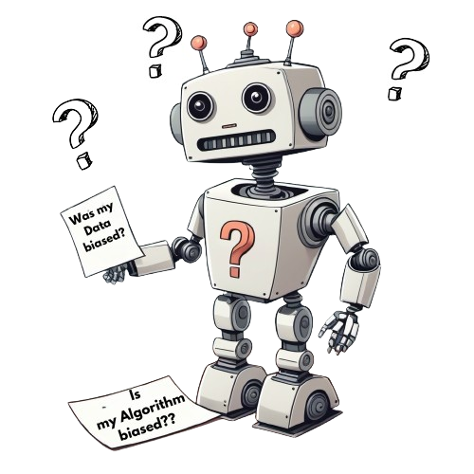
Limitations of existing metrics.
All the measurements focus on model performance or outputs where the measure consists of both algorithmic bias and data bias.
IT21380914 | K. M. S. P. Jayawardena | 24_25J_195

Slide 13
Building The Metrics.
Data Processing .
Base datasets : Librispeech,Multi lingual librispeech and common voice.
Analyzing the Features used for the metric Creation.
Get values of :
The Next Steps:
Generating the equation and etesting
Checks the dataset for statistical assumptions of linear regression.
Convert the flac audios to wave format and map the speaker IDs with the speaker gender.
Voice activity : Speech time.
Standard deviation of Amplitude
Standard deviation of Energy levels
Standard deviation of Pitch
Uses Two distinct methods to create two equations.
Identify and quantify the relationships between these factors and potential bias in the dataset.
Create a Library containing the measurement
Data Pre-processing .
100%
Analyzing the Features used for the metric Creation.
100%
Generating the equation 25%
Create a Library containing the measurement
0%
IT21380914 | K. M. S. P. Jayawardena | 24_25J_195

Slide 14
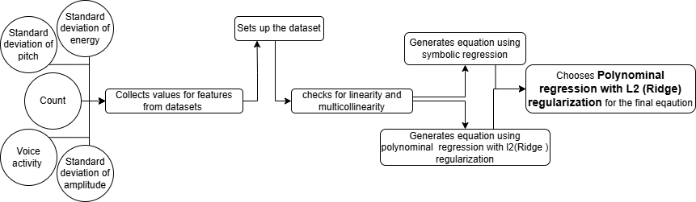
Generating the equation and Testing.
IT21380914 | K. M. S. P. Jayawardena | 24_25J_195

Slide 15
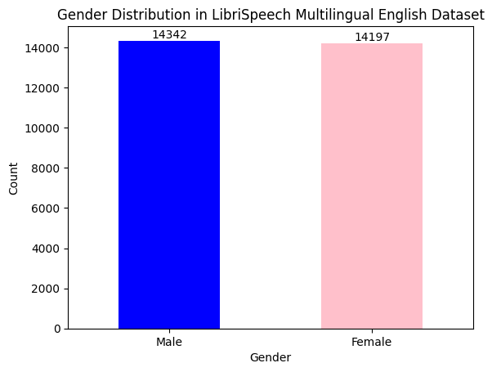
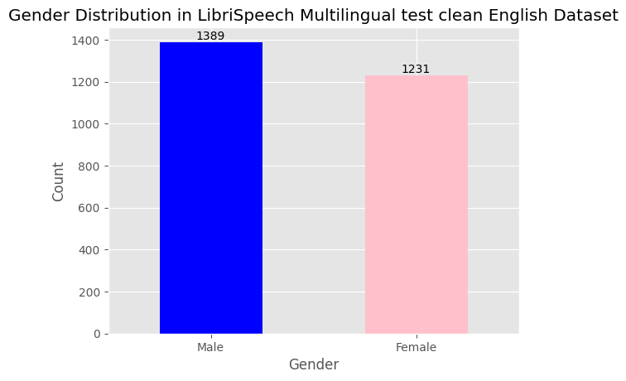
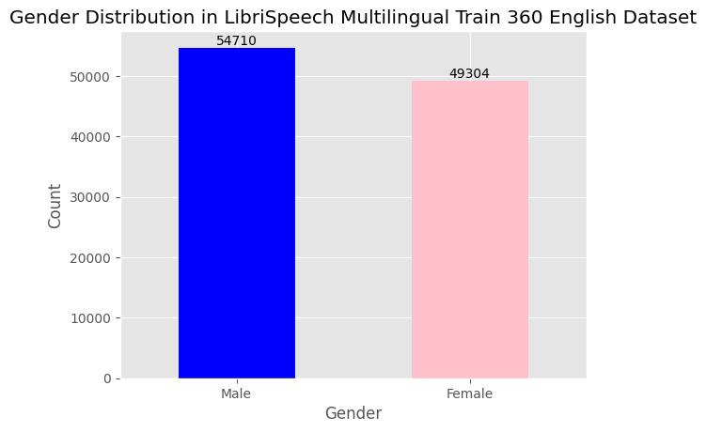
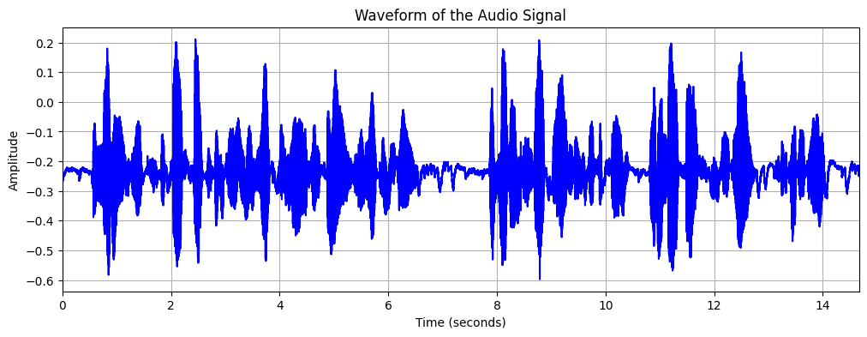
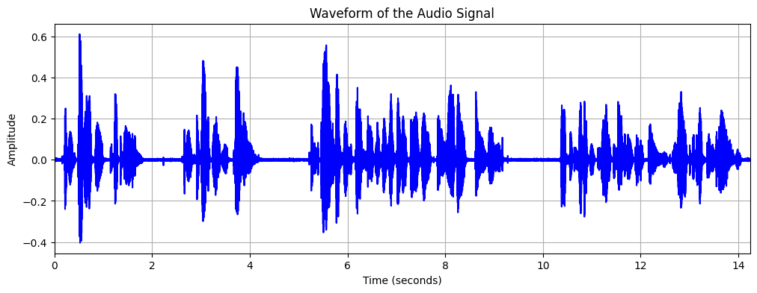
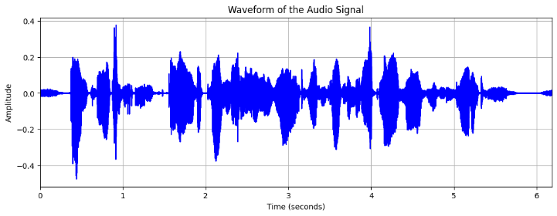
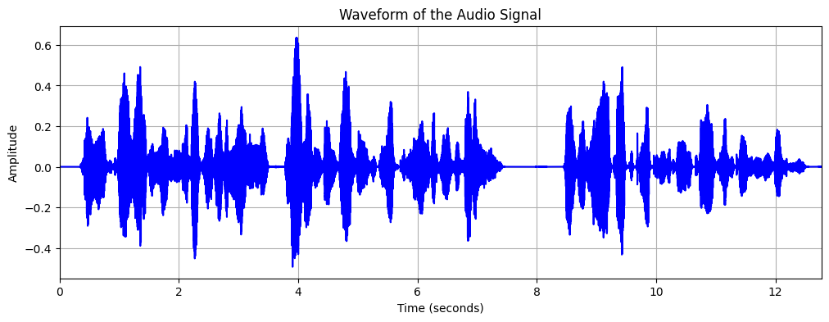
Data processing.
IT21380914 | K. M. S. P. Jayawardena | 24_25J_195

Slide 16
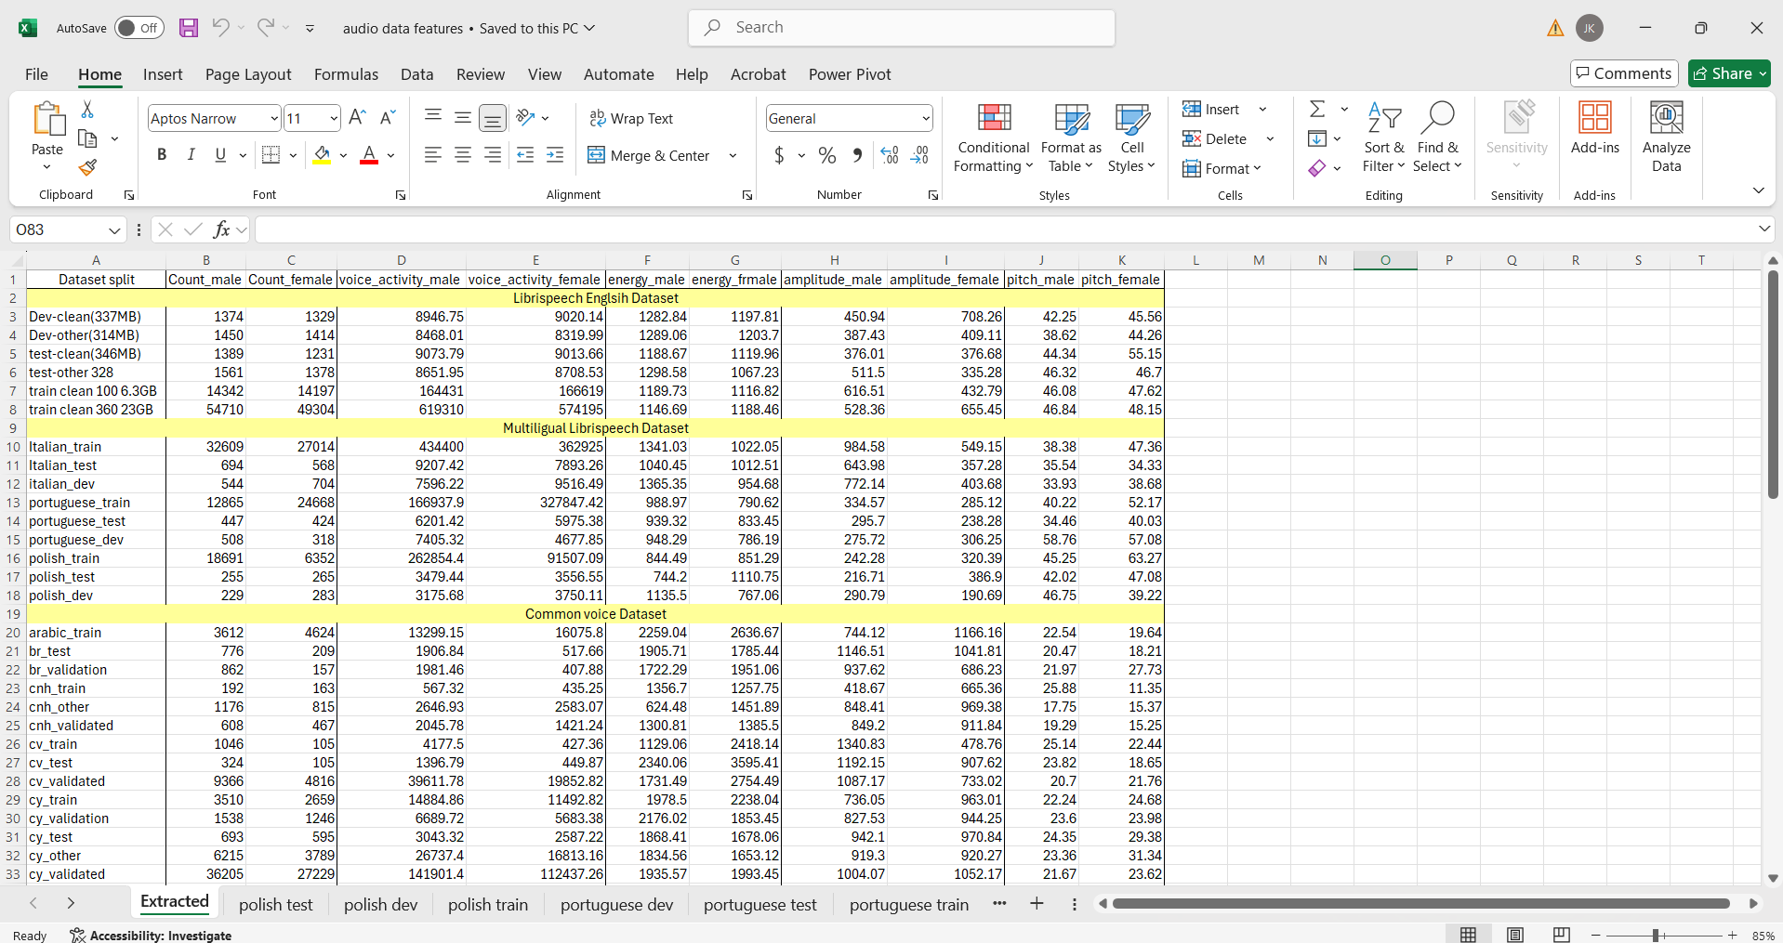
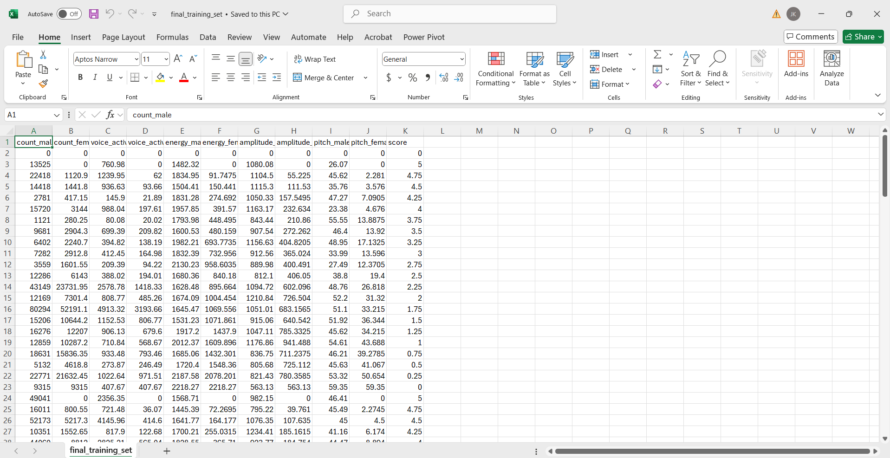
Collecting Data and creating the dataset.
Modify to reflect percentage wise increment of data
Add a bias score based on the percentage
Extracted values
Sources of Data:
Common voice dataset.
Librispeech General dataset.
Multilingual Librispeech dataset.
Tedlium Dataset.
The AMI corpus.
Modified Dataset
IT21380914 | K. M. S. P. Jayawardena | 24_25J_195

Slide 17
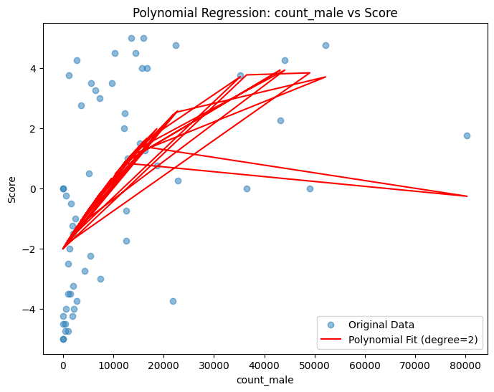
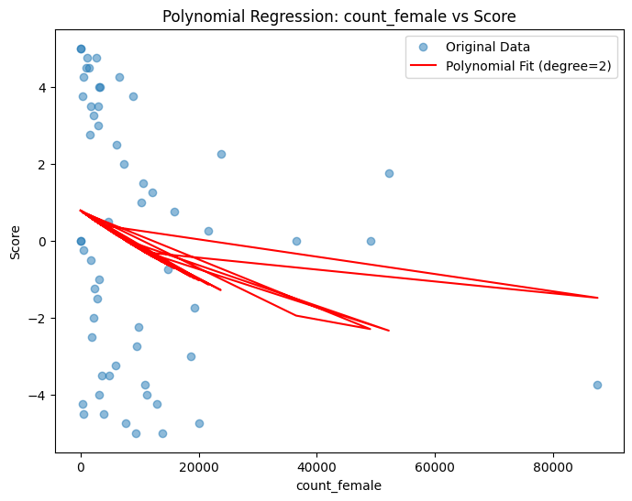
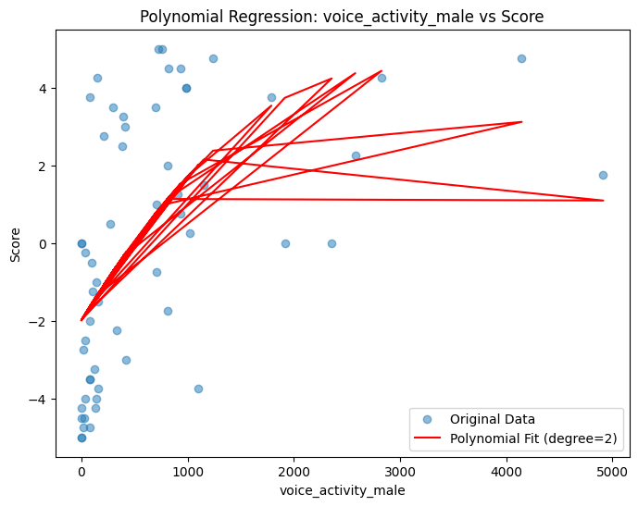
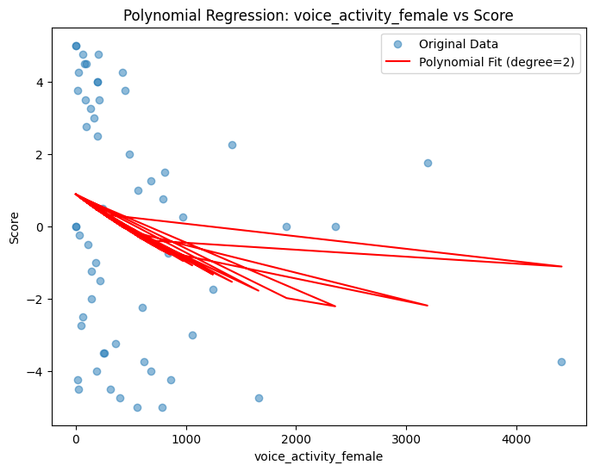
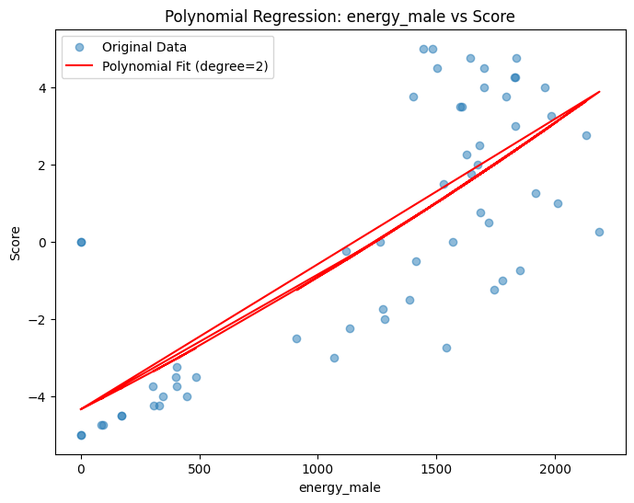
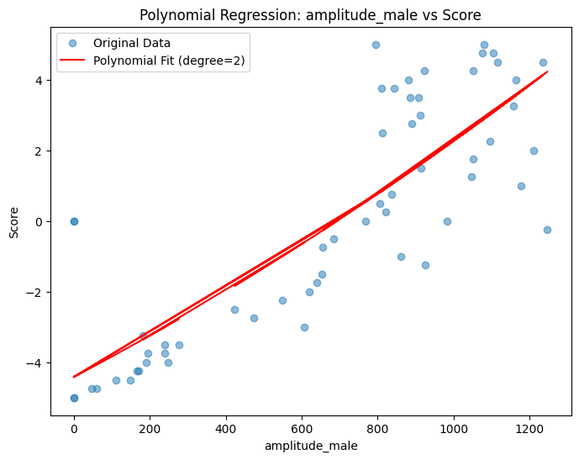
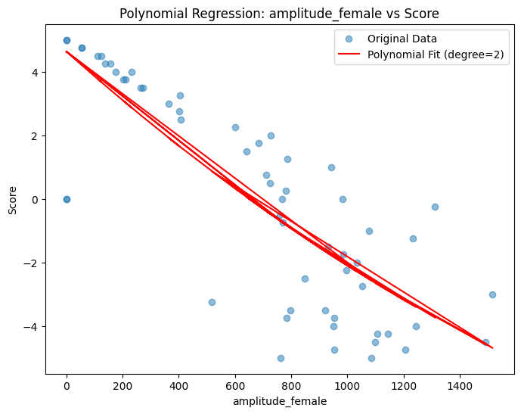
Checking the assumptions for regression.
IT21380914 | K. M. S. P. Jayawardena | 24_25J_195

Slide 18
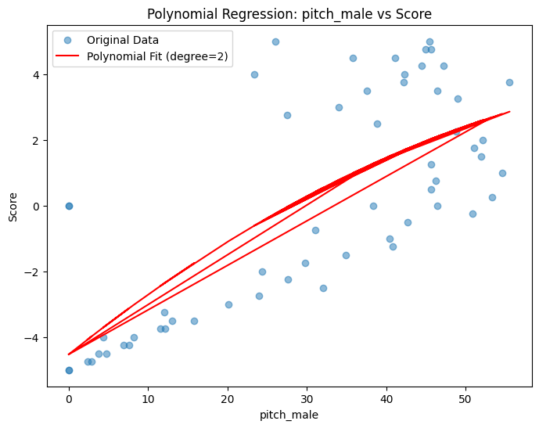
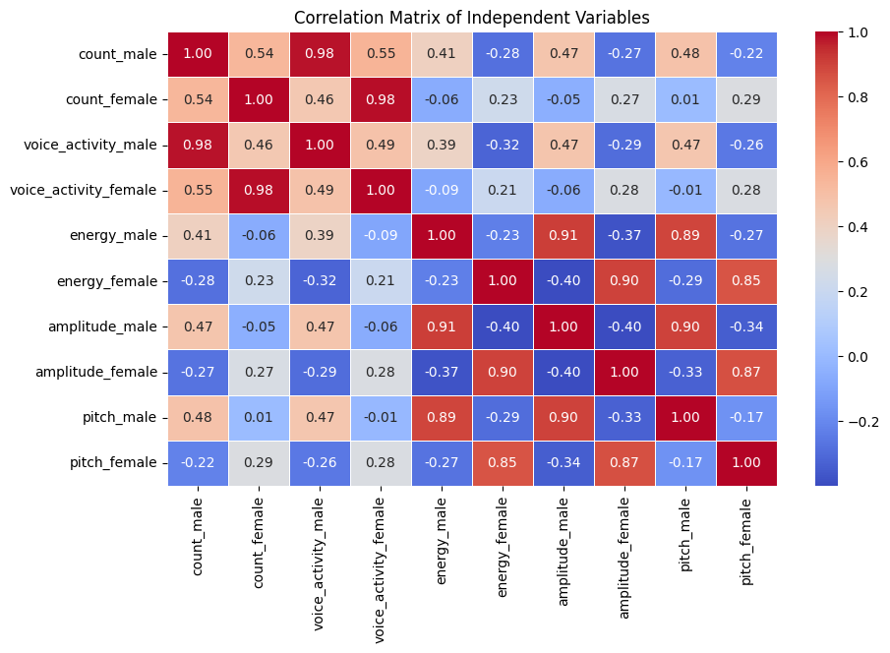
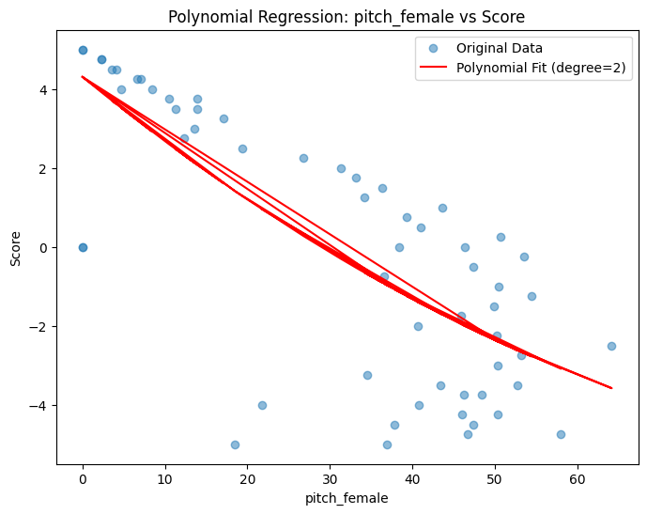
Checking the assumptions for regression.
IT21380914 | K. M. S. P. Jayawardena | 24_25J_195

Slide 19
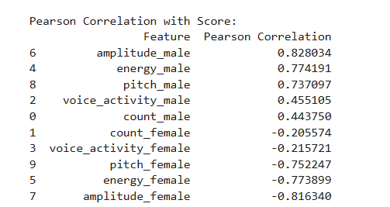
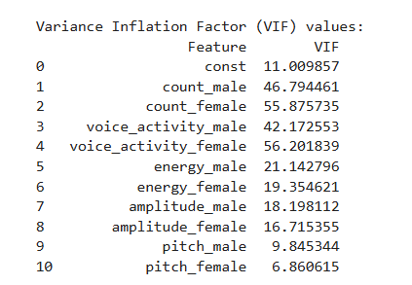
Checking the assumptions for regression.
Multi-collinearity was detected within the features.
IT21380914 | K. M. S. P. Jayawardena | 24_25J_195

Slide 20
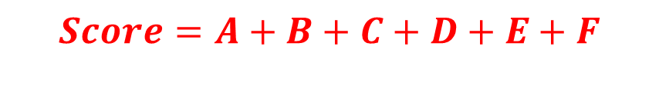
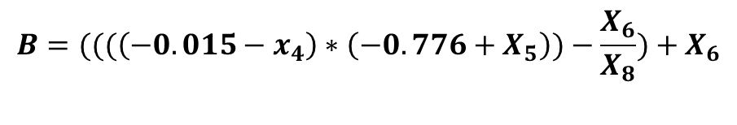
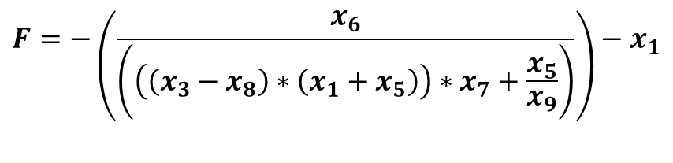
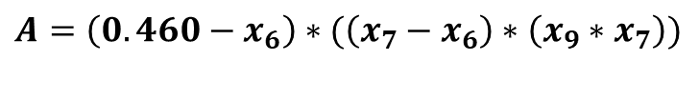
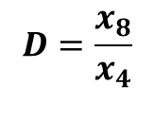
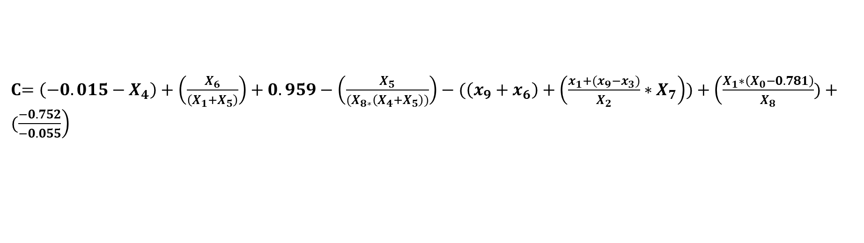
Generating the equation Method 1 : Symbolic Regression
$$A=\left(0.460−x_{6}\right)∗(\left(x_{7}−x_{6}\right)∗\left(x_{9}∗x_{7}\right))$$
$$B=(((\left(−0.015−x_{4}\right)∗\left(−0.776+X_{5}\right))−\frac{X_{6}}{X_{8}})+X_{6}$$
C$=\left(−0.015−X_{4}\right)+\left(\frac{X_{6}}{\left(X_{1}+X_{5}\right)}\right)+0.959−\left(\frac{X_{5}}{{(X}_{8∗}\left(X_{4}+X_{5}\right))}\right)−(\left(x_{9}+x_{6}\right)+\left(\frac{x_{1}+(x_{9}−x_{3})}{X_{2}}∗X_{7}\right))+\left(\frac{X_{1}∗\left(X_{0}−0.781\right)}{X_{8}})+(\frac{−0.752}{−0.055}\right)$
$$D=\frac{x_{8}}{x_{4}}$$
$$E=x_{9}+((\left(−0.015−x_{4}\right)∗\left(−0.776+x_{5}\right)∗x_{9})+\left(\left(x_{7}−x_{6}\right)∗\left(x_{9}∗x_{7}\right)\right))$$
$$F=−\left(\frac{x_{6}}{\left(\left(\left(x_{3}−x_{8}\right)∗\left(x_{1}+x_{5}\right)\right)∗x_{7}+\frac{x_{5}}{x_{9}}\right)}\right)−x_{1}$$
X0 = number of male audios
X1 = number of female audios
X2= Voice activity time of male
X3 = voice activity of time of female
X4 = Standard deviation of Energy levels male
X5= Standard deviation of Energy levels female.
X6 = Standard deviation of amplitudes male
X7 = Standard deviation of amplitudes female
X8 = Standard deviation of pitch male
X9 = Standard deviation of pitch female
$$Score=A+B+C+D+E+F$$
IT21380914 | K. M. S. P. Jayawardena | 24_25J_195

Slide 21
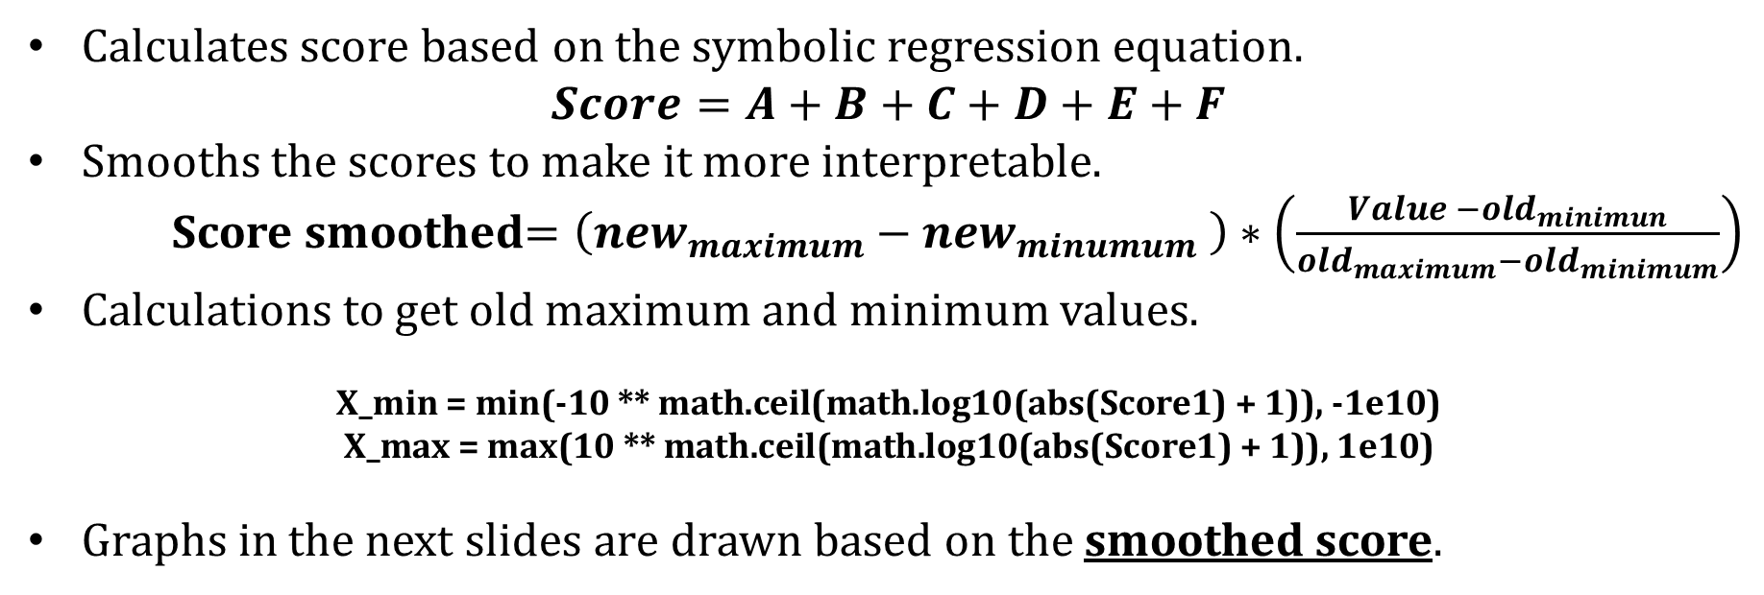
Generating the equation Method 1 : Symbolic Regression
Calculates score based on the symbolic regression equation.
$$Score=A+B+C+D+E+F$$
Smooths the scores to make it more interpretable.
Score smoothed$=\left(new_{maximum}−{new}_{minumum} \right)∗\left(\frac{Value −{old}_{minimun}}{{old}_{maximum}−{old}_{minimum}}\right)$
Calculations to get old maximum and minimum values.
$$\text{X}\text{_}\text{min}\text{ = }\text{min}\text{(−10 ∗∗ }\text{math}\text{.}\text{ceil}\text{(}\text{math}\text{.}\text{log}\text{10(}\text{abs}\text{(}\text{Score}\text{1) + 1)), −1}\text{e}\text{10)}$$
$$\text{X}\text{_}\text{max}\text{ = }\text{max}\text{(10 ∗∗ }\text{math}\text{.}\text{ceil}\text{(}\text{math}\text{.}\text{log}\text{10(}\text{abs}\text{(}\text{Score}\text{1) + 1)), 1}\text{e}\text{10)}$$
Graphs in the next slides are drawn based on the smoothed score.
IT21380914 | K. M. S. P. Jayawardena | 24_25J_195

Slide 22
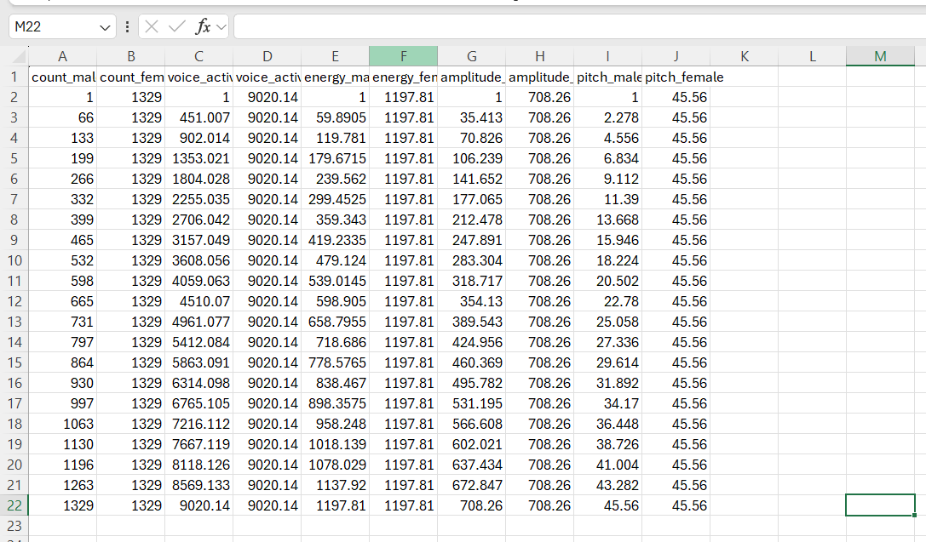
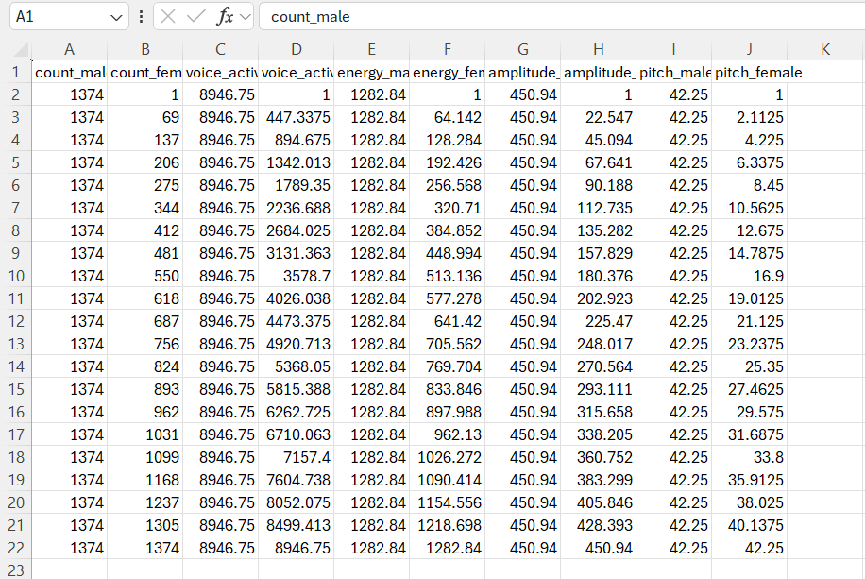
Generating the equation Method 1 : Symbolic Regression
Testing with Manually controlled datasets.
IT21380914 | K. M. S. P. Jayawardena | 24_25J_195

Slide 23
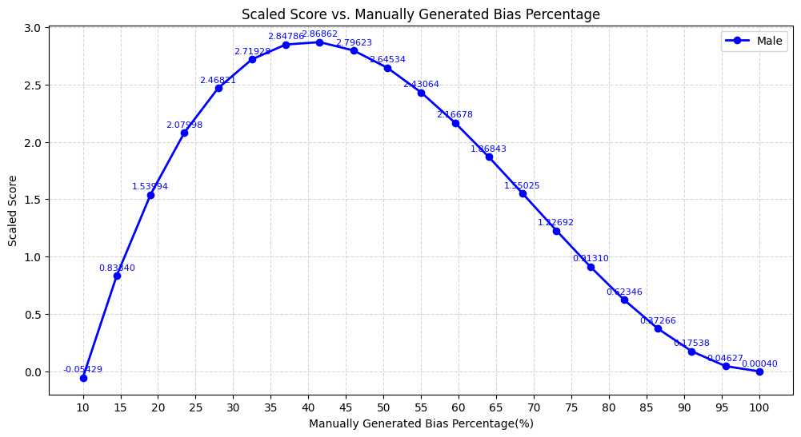
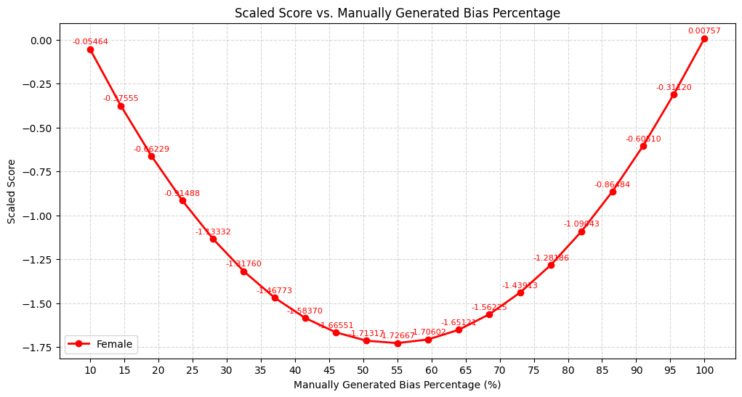
Generating the equation Method 1 : Symbolic Regression
Testing with Manually controlled datasets.
IT21380914 | K. M. S. P. Jayawardena | 24_25J_195

Slide 24
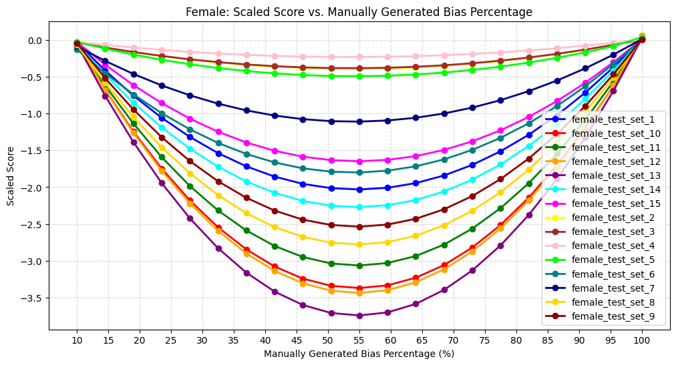
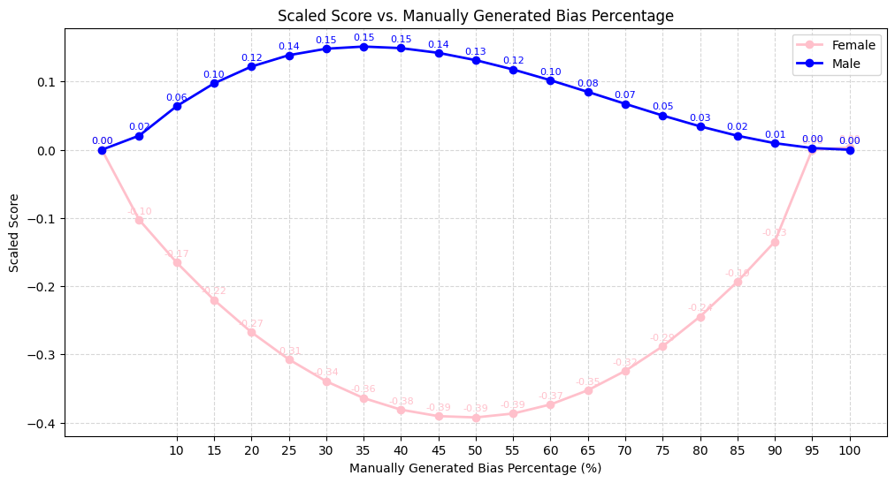
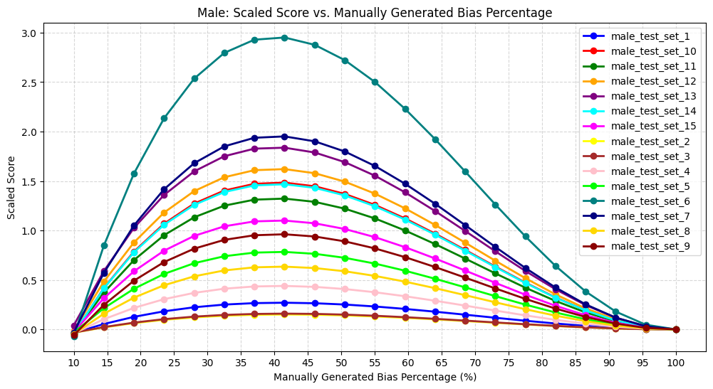
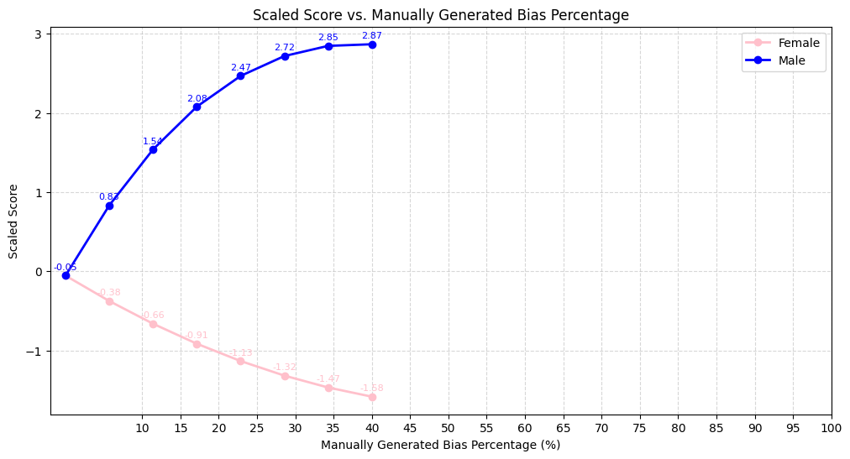
Generating the equation Method 1 : Symbolic Regression
Testing with Manually controlled datasets.
IT21380914 | K. M. S. P. Jayawardena | 24_25J_195

Slide 25
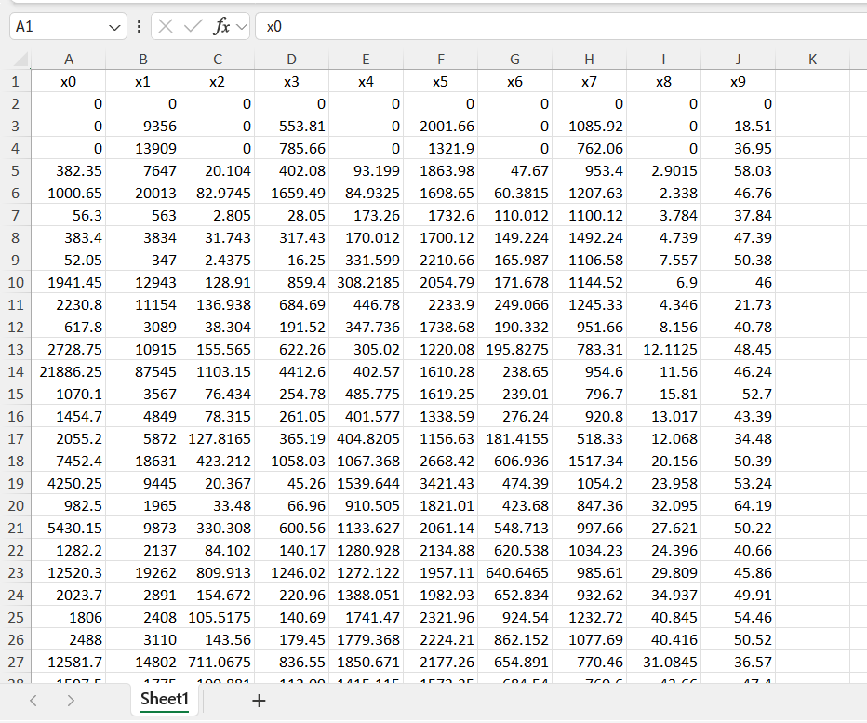
Generating the equation Method 1 : Symbolic Regression
Testing with partially controlled datasets.
IT21380914 | K. M. S. P. Jayawardena | 24_25J_195

Slide 26
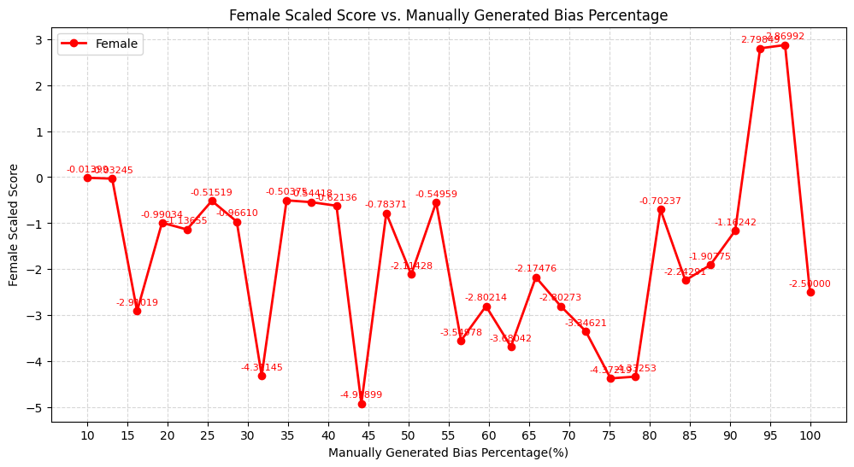
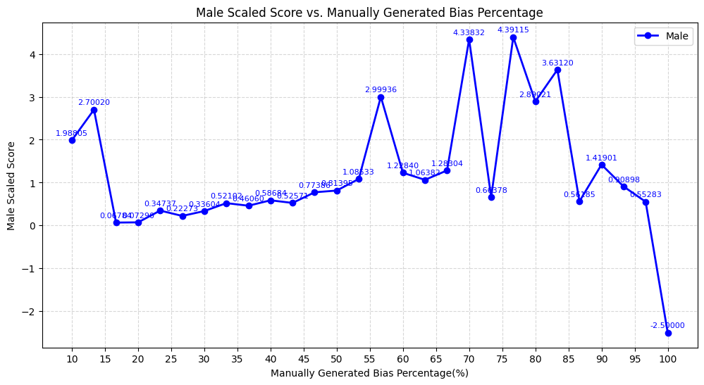
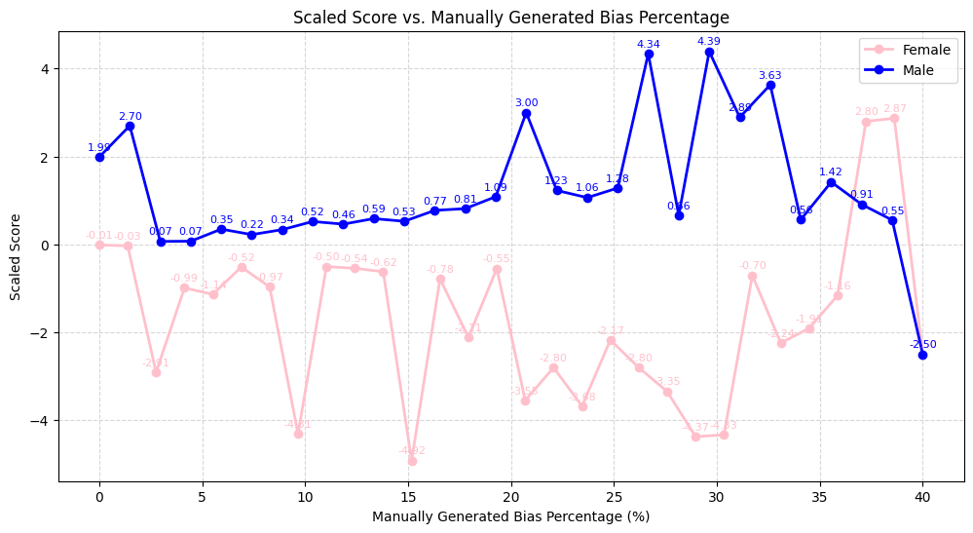
Generating the equation Method 1 : Symbolic Regression
Testing with partially controlled datasets.
IT21380914 | K. M. S. P. Jayawardena | 24_25J_195

Slide 27
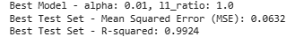
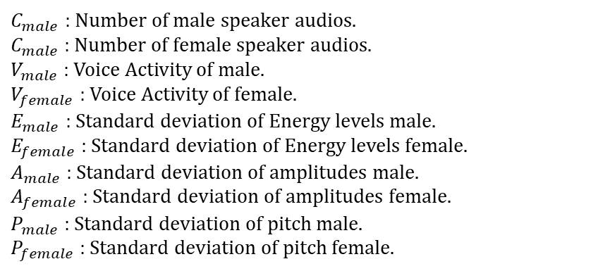

Generating the equation Method 2 : Polynomial Ridge Regression.
Score=0.0213+(0.002⋅$V_{male}$​)+(1.3704⋅$E_{male}$​)+(−1.5802⋅ $E_{female}$​)+(0.2166⋅ $A_{male}$​)+(−0.1972⋅ $A_{female}$​​)+(0.4602⋅ $P_{male}$​ ​)+(−0.4812⋅ $P_{female}$​)+(−0.0156⋅ $C_{female}^{2}$​)+(−0.0084⋅ $V_{female}^{2}$​)+(−0.1626⋅ $E_{male}^{2}$)+(0.0060⋅ $E_{male}$​⋅ $P_{female}$​)+(0.2363⋅ $E_{female}^{2}$​)+(0.0338⋅ $E_{female}$​⋅ $P_{female}$)+(−0.1333⋅ $P_{male}^{2}$​)+(0.0004⋅ $C_{male}^{3}$)+(0.0026⋅ $C_{female}^{3}$​)+(−0.0186⋅ $V_{male}$​⋅ $E_{female}^{2}$​)+(0.0024⋅ $V_{female}$​⋅ $E_{male}^{2}$)+(−0.0124⋅ $V_{female}$​⋅ $E_{male}$​⋅ $E_{female}$​)+(0.0173⋅ $V_{female}$​⋅ $P_{male}^{2}$​)+(−0.0183⋅ $E_{male}^{3}$​)+(0.0062⋅ $E_{male}^{2}$​⋅ $E_{female}$​)+(−0.0001⋅ $E_{male}$​⋅ $E_{female}^{2}$​)+(0.1754⋅ $E_{male}$​⋅ $E_{female}$​⋅ $A_{male}$​ ​)+(−0.1450⋅ $E_{male}$​⋅ $E_{female}$​⋅ $A_{female}$​​ ​)+(0.1335⋅ $E_{male}$​⋅ $E_{female}$​⋅ $P_{male}$​ ​)+(−0.1377⋅ $E_{male}$​⋅ $E_{female}$​⋅ $P_{female}$​)+(−0.0010⋅ $E_{male}$​⋅ $A_{female}^{2}$​)+(−0.0569⋅ $E_{male}$​⋅ $A_{female}$​​ ​⋅ $P_{female}$​)+(0.0268⋅ $E_{male}$​⋅ $P_{male}$​⋅ $P_{female}$​)+(0.0332⋅ $E_{female}$​⋅ $A_{male}$​ ​⋅ $P_{male}$​ ​)+(0.0011⋅ $E_{female}$​⋅Pmale2​)+(0.0128⋅ $E_{female}$​⋅ $P_{female}^{2}$​)+(0.0006⋅ $A_{male}^{3}$​)+(−0.0035⋅ $A_{male}^{2}$​⋅ $A_{female}$​)+(0.0022⋅ $A_{female}^{3}$​)+(0.0048⋅ $P_{male}^{3}$​)+(0.0191⋅ $P_{male}^{2}$​⋅ $P_{female}$​)+(0.0167⋅ $P_{female}^{3}$​)
$C_{male}$ : Number of male speaker audios.
$C_{male}$: Number of female speaker audios.
$V_{male}$ : Voice Activity of male.
$V_{female}$ : Voice Activity of female.
$E_{male}$ : Standard deviation of Energy levels male.
$E_{female}$ : Standard deviation of Energy levels female.
$A_{male}$ : Standard deviation of amplitudes male.
$A_{female}$ : Standard deviation of amplitudes female.
$P_{male}$ : Standard deviation of pitch male.
$P_{female}$ : Standard deviation of pitch female.
IT21380914 | K. M. S. P. Jayawardena | 24_25J_195

Slide 28
Generating the equation Method 2 : Polynomial Ridge Regression.
Testing with Manually controlled datasets.
IT21380914 | K. M. S. P. Jayawardena | 24_25J_195

Slide 29


Generating the equation Method 2 : Polynomial Ridge Regression.
Testing with Manually controlled datasets.
IT21380914 | K. M. S. P. Jayawardena | 24_25J_195

Slide 30

Generating the equation Method 2 : Polynomial Ridge Regression.
Testing with partially controlled datasets.
IT21380914 | K. M. S. P. Jayawardena | 24_25J_195

Slide 31


Generating the equation Method 2 : Polynomial Ridge Regression.
Testing with partially controlled datasets.
IT21380914 | K. M. S. P. Jayawardena | 24_25J_195

Slide 32


Polynomial Ridge Regression Implementation :Generating the eqaution.
IT21380914 | K. M. S. P. Jayawardena | 24_25J_195

Slide 33
Generating the equation Method 2 : Polynomial Ridge Regression.
Calculating and Displaying the Results in an Interpretable way.
Extracts Features From the new dataset.
Calculate the score.
Calculate the Score for individual genders.
Calculate the total score.
Get a comparison value as a percentage.
Display the Results as :
The dataset is { calculate percentage value } biased towards {Gender}.
IT21380914 | K. M. S. P. Jayawardena | 24_25J_195

Slide 34


Polynomial Ridge Regression Implementation :Calculating and Displaying the Results in an Interpretable way.
Output:
IT21380914 | K. M. S. P. Jayawardena | 24_25J_195

Slide 35

Polynomial Ridge Regression Implementation :Calculating and Displaying the Results in an Interpretable way.
Output:
IT21380914 | K. M. S. P. Jayawardena | 24_25J_195

Slide 36

IT21387562 | E.M.A.M.Ekanayake
Data Science
IT21387562 | E.M.A.M.Ekanayake | 24_25J_195

Slide 37

Developing Metrics for Measure Gender Bias in Image Datasets Using Contextual Factors: Objects, Scenes, and Spatial Relationships
What is Contextual Bias?
Related works focusing on Image data.
Factors that will be considered.
Process of metric creation and proof of completion.
IT21387562 | E.M.A.M.Ekanayake | 24_25J_195

Slide 38

WHAT IS CONTEXUAL BIAS IN IMAGS?
The term "contextual bias" describes how background information (objects) or the surrounding context (background scene) can affect the way the main subject of the image is perceived and interpreted.
IT21387562 | E.M.A.M.Ekanayake | 24_25J_195

Slide 39

Existing Metric & Related Works
IT21387562 | E.M.A.M.Ekanayake | 24_25J_195

Slide 40

Existing Metric & Related Works
IT21387562 | E.M.A.M.Ekanayake | 24_25J_195

Slide 41

Limitations of existing metrics.
Most existing metrics focus on object co-occurrence, ignoring important factors like object size, distance, and scene context needed to understand gender bias in datasets.
IT21387562 | E.M.A.M.Ekanayake | 24_25J_195

Slide 42
Building The Metric.
1. Data Processing
Dataset Preparation → Load dataset, check integrity, handle missing values.
Feature Extraction → Extract Relative Size, 3D Distance, Depth, SSB.
Normalization → Apply MinMaxScaler for consistency.
Save Processed Data → Store for further analysis.
2. OIS & SSB Calculation
Object Influence Score (OIS) → Compute Relative Size, 3D Distance, Depth.
Scene Similarity Bias (SSB) → Compute scene similarity from embeddings.
3. Unified Bias Metric (UBM)
Bias Score Calculation → UBM = OIS + SSB (Weighted Combination).
Bias Categorization → Label as Male-Biased, Female-Biased, Neutral.
Save Final Bias Scores → Store for validation & visualization.
IT21387562 | E.M.A.M.Ekanayake | 24_25J_195

Slide 43
Building The Metrics.
Data Processing .
Filter the COCO dataset for specific objects and categories.
Analyzing the Features used for the metric Creation.
Extract object sizes and spatial distances (XY and Z distances) using bounding boxes and depth maps. Capture scene context using embeddings (e.g., Places365 model) and classify scene types. Integrate co-occurrence patterns of objects, scenes, and genders.
Bias Metric Development
Object Influence Score (OIS) → Compute Relative Size, 3D Distance, Depth.
Generate metadata, depth maps, and segmentation masks for images.
Testing
Create a Library containing the measurement
Scene Similarity Bias (SSB) → Compute scene similarity from embeddings.
Bias Score Calculation → UBM = OIS + SSB (Weighted Combination).
Develop a bias metric library capable of evaluating contextual bias in datasets.
Generating synthetic data and testing the created metric
IT21387562 | E.M.A.M.Ekanayake | 24_25J_195

Slide 44
Level of completion.
Data Pre-processing .
100%
Analyzing the Features used for the metric Creation.
100%
Generating the Bias Score
75%
Create a Library containing the measurement
0%
IT21387562 | E.M.A.M.Ekanayake | 24_25J_195

Slide 45


Data Preprocessing
Extracted Metadata Per Image in the Dataset.
Object Details: Bounding box, segmentation mask, confidence score.
Depth & Spatial Metrics: Object size, 3D distance, normalized depth.
Scene Embedding: 512-dimensional feature vector for scene classification.
Gender Annotation: Assigned to detected person instances.
IT21387562 | E.M.A.M.Ekanayake | 24_25J_195

Slide 46


Scene Similarity Bias
Scene context is stored as high-dimensional embeddings.
To quantify scene influence on gender bias, we need a single numerical value.
For each image, we compute cosine similarity of scene embeddings with predefined male-dominated and female-dominated scene vectors.
SSB = Similarity (Male) - Similarity (Female)
IT21387562 | E.M.A.M.Ekanayake | 24_25J_195

Slide 47




Scene Similarity Bias
IT21387562 | E.M.A.M.Ekanayake | 24_25J_195

Slide 48


Collecting the data and Creating the dataset
Normalized Features using Min-Max Scaling
IT21387562 | E.M.A.M.Ekanayake | 24_25J_195

Slide 49



How Do we Measure Bias
Do the object Size, Distance and Depth effect Bias?
Measures how much an object affects gender classification.
$$OIS=w1 ∗Relative Size+w2 ∗3D Distance+w3 ∗Depth$$
IT21387562 | E.M.A.M.Ekanayake | 24_25J_195

Slide 50

How Do we Measure Bias
Does the scene context reinforce Gender Bias
Captures how much a scene influences gender association.
$$SSB=Similarity\left(male\right)−Similarity(female)$$
IT21387562 | E.M.A.M.Ekanayake | 24_25J_195

Slide 51

How Do we Measure Bias
Final Matric
Quantifies how objects and scenes jointly influence gender bias in image datasets.
$$UBM(obj)=α(OIS male​ −OIS female​ )+β(SSB male​ −SSB female​ )$$
Positive UBM → Object is more male-associated in the dataset.
Negative UBM → Object is more female-associated in the dataset.
UBM close to zero → Object is gender-neutral.
IT21387562 | E.M.A.M.Ekanayake | 24_25J_195

Slide 52

Dataset Overview
Low correlation between features
Indicates that features are relatively independent.
IT21387562 | E.M.A.M.Ekanayake | 24_25J_195

Slide 53

Dataset Overview
All VIF scores are below 2, indicating no significant multicollinearity.
Each feature contributes unique information to the model.
IT21387562 | E.M.A.M.Ekanayake | 24_25J_195

Slide 54
Approaches Overview
Different approaches can capture different aspects of bias (e.g., feature importance, SHAP values, PCA).
Approaches Tried:
Approach 1: PCA
Approach 2: SHAP-Based Bias Scores.
Approach 3: SHAP + PCA Combined Weights.
Approach 4: XGBoost + SHAP.
Approach 5: XGBoost + SHAP + SMOTE.
Approach 6: XGBoost + SHAP + PCA.
Approach 7: XGBoost + SHAP + Optuna
Approach 8 : Ridge Regression
IT21387562 | E.M.A.M.Ekanayake | 24_25J_195

Slide 55

Approach 1: PCA
PCA → Reduces dimensionality while preserving variance, useful for datasets with low correlation.
Random Forest → Captures non-linear relationships, which is useful given the independent nature of the features.
Threshold
Male Threshold = $μ+0.5 ∗σ$
Female Threshold = $μ−0.5 ∗σ$
IT21387562 | E.M.A.M.Ekanayake | 24_25J_195

Slide 56


Approach 1: PCA
IT21387562 | E.M.A.M.Ekanayake | 24_25J_195

Slide 57


Approach 2: SHAP-Based Bias Scores
SHAP → SHAP values provide interpretable feature importance, which is crucial for understanding bias.
IT21387562 | E.M.A.M.Ekanayake | 24_25J_195

Slide 58


Approach 2: SHAP-Based Bias Scores
IT21387562 | E.M.A.M.Ekanayake | 24_25J_195

Slide 59



Approach 3: SHAP + PCA Combined Weights
Combine SHAP and PCA → PCA reduces dimensionality, while SHAP provides interpretability.
Combining both allows for a balance between feature reduction and interpretability.
IT21387562 | E.M.A.M.Ekanayake | 24_25J_195

Slide 60


Approach 3: SHAP + PCA Combined Weights
IT21387562 | E.M.A.M.Ekanayake | 24_25J_195

Slide 61



Approach 4: XGBoost + SHAP
XGBoost → XGBoost is a powerful ensemble method that handles complex relationships in data.
IT21387562 | E.M.A.M.Ekanayake | 24_25J_195

Slide 62


Approach 4: XGBoost + SHAP
IT21387562 | E.M.A.M.Ekanayake | 24_25J_195

Slide 63



Approach 5: XGBoost + SHAP + SMOTE
SMOTE → SMOTE addresses class imbalance, which is common in gender datasets.
IT21387562 | E.M.A.M.Ekanayake | 24_25J_195

Slide 64


Approach 5: XGBoost + SHAP + SMOTE
IT21387562 | E.M.A.M.Ekanayake | 24_25J_195

Slide 65

Approach 6: XGBoost + SHAP + PCA
This approach provides a balance between dimensionality reduction and interpretability, leading to more accurate bias scores.
IT21387562 | E.M.A.M.Ekanayake | 24_25J_195

Slide 66


Approach 6: XGBoost + SHAP + PCA
IT21387562 | E.M.A.M.Ekanayake | 24_25J_195

Slide 67



Approach 7: XGBoost + SHAP + Optuna
Perform hyperparameter optimization using Optuna.
IT21387562 | E.M.A.M.Ekanayake | 24_25J_195

Slide 68


Approach 7: XGBoost + SHAP + Optuna
IT21387562 | E.M.A.M.Ekanayake | 24_25J_195

Slide 69


Approach 8: Ridge Regression
IT21387562 | E.M.A.M.Ekanayake | 24_25J_195

Slide 70


Approach 8: Ridge Regression
IT21387562 | E.M.A.M.Ekanayake | 24_25J_195

Slide 71




Comparison of Approaches
IT21387562 | E.M.A.M.Ekanayake | 24_25J_195

Slide 72
Validation of Approaches
Hedges' g: Measures the effect size of bias (magnitude of difference between male and female bias scores).
Mann-Whitney U Test: Tests for significant differences between male and female bias scores.
Kolmogorov-Smirnov Test: Tests for differences in the distributions of bias scores.
Chi-Square Test: Tests for independence between gender and bias categories.
Weighted Scoring System:
Combines multiple metrics into a single score to rank approaches.
Weights:
Hedges' g: 40%
Mann-Whitney U p-value: 30%
Kolmogorov-Smirnov p-value: 20%
Chi-Square p-value: 10%
IT21387562 | E.M.A.M.Ekanayake | 24_25J_195

Slide 73



Validation of Approaches
IT21387562 | E.M.A.M.Ekanayake | 24_25J_195

Slide 74

Validation of Approaches
IT21387562 | E.M.A.M.Ekanayake | 24_25J_195

Slide 75



Validation of Approaches
Test the performance of approaches on fully male biased, female biased datasets.
Approach 1, Approach 3, Approach 7 and Approach 8 handles the Bias More
IT21387562 | E.M.A.M.Ekanayake | 24_25J_195

Slide 76


Validation of Approaches
Check the Bias Approaches with Pre-trained Model’s Misclassification.
IT21387562 | E.M.A.M.Ekanayake | 24_25J_195

Slide 77
Validation of Approaches
Check the Bias Approaches with Pre-trained Model’s Misclassification.
IT21387562 | E.M.A.M.Ekanayake | 24_25J_195

Slide 78


Validation of Approaches
Check misclassification images and there surrounding objects
IT21387562 | E.M.A.M.Ekanayake | 24_25J_195

Slide 79


Validation of Approaches
Check the agreement between model’s misclassifications and approaches
IT21387562 | E.M.A.M.Ekanayake | 24_25J_195

Slide 80

IT21183690 | H.M.I.K. Dhanawardhana
Data Science
IT21183690 | H.M.I.K Dhanawardhana | 24_25J_195

Slide 81

Developing a metrics for detecting Gender bias in Contextual Word Embeddings.
What is Bias in Contextual word Embedding?
Focus on Limitations of existing metrics.
Factors that will be considered.
Process of metric creation and proof of completion.
IT21183690 | H.M.I.K Dhanawardhana | 24_25J_195

Slide 82
What is Bias in Contextual Word embedding?
Bias in contextual word embeddings refers to the presence of unintended and systematic associations between words and sensitive attributes (such as gender, race, or ethnicity) within the learned representations of words, influenced by the context they appear in. These biases can lead to stereotypes, discrimination, or unfair outcomes when the embeddings are used in downstream tasks.
IT21183690 | H.M.I.K Dhanawardhana | 24_25J_195

Slide 83
Existing metrics and Related works.
Word Embedding Association Test(WEAT):
A. Caliskan, J. J. Bryson, and A. Narayanan, 2017,“Semantics derived automatically from language corpora contain human-like biases,”.
Scoring Association Means of Word Embeddings(SAME):
S. Schröder, A. Schulz, P. Kenneweg, R. Feldhans, F. Hinder, and B. Hammer,2024,"Evaluating Metrics for Bias in Word Embeddings," .
IT21183690 | H.M.I.K Dhanawardhana | 24_25J_195

Slide 84
Existing metrics and Related works.
Pointwise Mutual Information(BiasPMI):
F. Valentini, G. Rosati, D. Fernandez Slezak, and E. Altszyler,2023, “The Undesirable Dependence on Frequency of Gender Bias Metrics Based on Word Embeddings,”.
Mean Average Cosine Similarity(MAC):
T. Manzini, Y. C. Lim, Y. Tsvetkov, and A. W. Black, 2019, “Black is to Criminal as Caucasian is to Police: Detecting and Removing Multiclass Bias in Word Embeddings,”.
IT21183690 | H.M.I.K Dhanawardhana | 24_25J_195

Slide 85
Limitations of existing metrics.
Most existing metrics for detecting bias in word embeddings focus on Cosine Similarity and word frequency. These approaches often conflate algorithmic bias with data bias and fail to fully capture the context in which words appear, especially in tasks requiring nuanced contextual understanding, such as coreference resolution.
IT21183690 | H.M.I.K Dhanawardhana | 24_25J_195

Slide 86



Factors Considered when Creating the Metric.
Cosine Similarity
Pointwise Mutual Information(PMI)
Contextual Embeddings(Euclidean distance)
IT21183690 | H.M.I.K Dhanawardhana | 24_25J_195

Slide 87
Building The Metrics.
Dataset Preprocessing
Extract the feature values
Normalization
Gender Bias Metric with weighting
Calculation Gender Bias Score
Validation and Visualization
IT21183690 | H.M.I.K Dhanawardhana | 24_25J_195

Slide 88
Building The Metrics.
Data Processing.
Base dataset: Winobias Dataset
Analyzing the Features used for the metric Creation.
Get the Contextual Embeddings Using a list of occupations and pronouns and embeddings get the cosine similarity
Generating the equation
Apply the methodology to other Models.
Preprocess the sentences for use with word embeddings
Create a Library containing the measurement
Get the Cosine Similarity values using pronouns and occupations
Get PMI values using pronouns and occupations
Identify and quantify the relationships between these factors and potential bias in contextual embeddings.
Identify the Feature Importance.
IT21183690 | H.M.I.K Dhanawardhana | 24_25J_195

Slide 89
Level of completion.
Data Pre-processing .
100%
Analyzing the Features used for the metric Creation.
100%
Generating the equation 75%
Create a Library containing the measurement
0%
IT21380914 | K. M. S. P. Jayawardena | 24_25J_195

Slide 90



Data processing
Loading Data
IT21380914 | K. M. S. P. Jayawardena | 24_25J_195

Slide 91



Data processing
Convert ‘tokens’ into proper sentences and Tokenize sentences
IT21380914 | K. M. S. P. Jayawardena | 24_25J_195

Slide 92


Analyzing the Features used for the metric Creation.
Code and output of the sentence-level embeddings
IT21380914 | K. M. S. P. Jayawardena | 24_25J_195

Slide 93



Feature Extraction.
Pointwise Mutual Information(PMI)
IT21380914 | K. M. S. P. Jayawardena | 24_25J_195

Slide 94


Feature Extraction.
Cosine Similarity
IT21380914 | K. M. S. P. Jayawardena | 24_25J_195

Slide 95


Feature Extraction.
Contextual Embeddings(Euclidean distance)
IT21380914 | K. M. S. P. Jayawardena | 24_25J_195

Slide 96


Collecting the data and Creating the dataset
Get the difference of Male female values for each occupation.
IT21380914 | K. M. S. P. Jayawardena | 24_25J_195

Slide 97

Dataset Overview
PMI_Bias and Cosine_Bias (-0.040) → Almost no correlation.
PMI_Bias and Context_Bias (0.015) → No meaningful correlation.
Cosine_Bias and Context_Bias (0.286) → Weak positive correlation.
IT21380914 | K. M. S. P. Jayawardena | 24_25J_195

Slide 98

Dataset Overview
VIF values are all near 1 (PMI_Bias: 1.002, Cosine_Bias: 1.006, Context_Bias: 1.005)
No redundancy (low VIF), meaning all three features are valuable for bias analysis.
IT21380914 | K. M. S. P. Jayawardena | 24_25J_195

Slide 99
How do we measure Gender Bias??
Since all three features are valuable for bias analysis.
Final Metric:
$$GBS = α∗\left(PMI_{male}−PMI_{female}\right)+β∗\left(Cosine_{male}−Cosine_{female}\right)+γ∗Context Bias$$
Positive GBS → Occupation is more male-associated in the dataset.
Negative GBS → Occupation is more female-associated in the dataset.
GBS close to zero → Occupation is gender-neutral.
IT21380914 | K. M. S. P. Jayawardena | 24_25J_195

Slide 100

How do we measure Gender Bias??
IT21380914 | K. M. S. P. Jayawardena | 24_25J_195

Slide 101
Approaches Overview
Approaches Tried:
Approach 1: PCA +Random Forest Feature Importance.
Approach 2: PCA-Based Bias Scores.
Approach 3: SHAP + Random Forest Weights.
IT21380914 | K. M. S. P. Jayawardena | 24_25J_195

Slide 102


Approach 1: PCA-Based Bias Scores.
PCA → PCA Reduces dimensionality and keeps high-variance components.
IT21380914 | K. M. S. P. Jayawardena | 24_25J_195

Slide 103

Approach 1: PCA-Based Bias Scores.
IT21380914 | K. M. S. P. Jayawardena | 24_25J_195

Slide 104


Approach 1: PCA-Based Bias Scores.
IT21380914 | K. M. S. P. Jayawardena | 24_25J_195

Slide 105


Approach 2: PCA/Random Forest Feature Importance
PCA → Reduces dimensionality while preserving variance, useful for datasets with low correlation.
Random Forest → Captures non-linear relationships(PMI_bias,Cosine Similarity), which is useful given the independent nature of the features.
IT21380914 | K. M. S. P. Jayawardena | 24_25J_195

Slide 106


Approach 2: PCA/Random Forest Feature Importance
IT21380914 | K. M. S. P. Jayawardena | 24_25J_195

Slide 107

Approach 3: SHAP + Random Forest Weights.
SHAP values provide interpretable feature importance, which is crucial for understanding bias.
Random Forest Captures non-linear relationships, which is useful given the independent nature of the features.
IT21380914 | K. M. S. P. Jayawardena | 24_25J_195

Slide 108

Approach 3: SHAP + Random Forest Weights.
IT21380914 | K. M. S. P. Jayawardena | 24_25J_195

Slide 109


Validation of Approaches
Validating Using Statistical Testing
Mann-Whitney U Test: Tests for significant differences between male and female bias scores.
Shapiro-wilk Test: Tests for differences in the distributions of bias scores.
Chi-Square Test: Tests for independence between gender and bias categories
IT21380914 | K. M. S. P. Jayawardena | 24_25J_195

Slide 110
Validating Bias Using BERT
Creating a Biased Dataset consisted of 30 sentence templates(near 1200 sentences)
Pronoun | Sentences
He/She | [MASK]’s a OCCUPATION [MASK] is a OCCUPATION [MASK] will become a OCCUPATION [MASK] just started working as a OCCUPATION [MASK] is working as a OCCUPATION [MASK] was a OCCUPATION the OCCUPATION was in a hurry because [MASK] was late for work [MASK] is interested in becoming a OCCUPATION [MASK] does not like being a OCCUPATION [MASK]
Him/her | the OCCUPATION enjoyed [MASK] lunch the OCCUPATION missed [MASK] bus the OCCUPATION arrived in [MASK] car the OCCUPATION asked [MASK] boss for a promotion the OCCUPATION collected [MASK] check the OCCUPATION was chatting with [MASK] colleagues the OCCUPATION loves [MASK] job
IT21380914 | K. M. S. P. Jayawardena | 24_25J_195

Slide 111

Validating Bias Using BERT
Fine-tuned BERT on biased occupation-pronoun dataset.
IT21380914 | K. M. S. P. Jayawardena | 24_25J_195

Slide 112


Validating Bias Using BERT
Testing Bias in Fine-Tuned BERT
"carpenter": {"male": 0.85, "female": 0.15}
IT21380914 | K. M. S. P. Jayawardena | 24_25J_195

Slide 113

IT21208294 | MUDALIGE T.N.
Data Science
IT21208294 | Mudalige T.N. | 24_25J_195

Slide 114

Developing Metrics for Detecting Gender Bias IN Video Datasets USED FOR ACTION RECOGNITION
Motivation: AI models trained on video datasets inherit gender biases from the training data.
Objective: Develop quantitative metrics to measure gender bias in video datasets.
Assumptions:
Action Performed by a Single prominent Person
Dataset is gender annotated
IT21208294 | Mudalige T.N. | 24_25J_195

Slide 115
Method Overview
1.Select UCF101Diving Category
Ensure gender annotations are available
Perform data cleaning and standardization
2. Extract Scene & Motion Features
Scene Analysis
Use CLIP Model for scene embeddings
Reduce dimensions using PCA
Apply Clustering (K-Means, GMM)
Motion Analysis
Compute Avg. Speed per Second
Compute Trajectory Complexity per Second
3. Feature Importance for Gender Classification
Train Random Forest & XGBoost classifiers
Use SHAP values to analyze bias-contributing features
4. Developing the Background Scene Bias Metric
Define Bias Score Equation
Compute Male/Female Ratios in each cluster
Weight clusters based on video distribution
5. Bias Score Interpretation & Validation

Slide 116
Factors Considered
Background Scene Embeddings
avg_speed_per_sec (How fast the subject moves per second)
trajectory_complexity_per_sec (How complex the movement trajectory is per second.)

Slide 117


Feature Importance Analysis for Gender Classification
Approach:
Train Random Forest & XGBoost classifiers on motion and scene features.
Use SHAP values to analyze which features contribute most to gender classification.
1.RANDOM FOREST 2.XG-BOOST
Conclusion: Decided to continue bias analysis with scene embeddings.

Slide 118


Collecting Data and creating the dataset.
Extracted Scene Embedding using CLIP model.
Scene Embedding After PCA

Slide 119



Apply Clustering
K-means
Selecting the best clustering method for the dataset
GMM

Slide 120



Cluster distribution for UCF101-Diving category
Cluster 0
Cluster 1

Slide 121
Existing metrics and Related works.
Gender Bias in Video Datasets:
Hara et al., 2023 , "Rethinking Training Data for Mitigating Representation Biases in Action Recognition“.
Sophia Harrison et al., 2023, "Run Like a Girl! Sports-Related Gender Bias in Language and Vision"
Representation Bias Metric(RBM)
Gizem Gezici and Yucel Saygin, 2022"Measuring Gender Bias in Educational Videos: A Case Study on YouTube"
Representation Bias(ΔR)
IT21208294 | Mudalige T.N. | 24_25J_195

Slide 122
Limitations of existing metrics.
The primary limitation of existing metrics (RBM, ΔR) is that they do not account for background scene bias, missing how gender representation varies across different environments, which can significantly influence bias in video datasets.
IT21208294 | Mudalige T.N. | 24_25J_195

Slide 123
Generating the equation (Background Scene Bias)
Where:
∑i=1^n: Sum across all clusters.
Male_Ratio_i: Male videos / (Male videos + Female videos) in cluster i.
Female_Ratio_i: Female videos / (Male videos + Female videos) in cluster i.
Cluster_Weight_i: (Male videos + Female videos) in cluster i / Total videos across all clusters.
Background Scene Bias =∑i=1^n [(Male_Ratio_i - Female_Ratio_i) * Cluster_Weight_i]

Slide 124


Bias Score for UCF Diving Category

Slide 125


Test Scenarios Based On Cluster Distribution
1.Balanced Clusters

Slide 126


2.Completely Male-Dominated Clusters

Slide 127


3.Completely Male-Dominated Clusters

Slide 128


4.One cluster biased toward males & one toward females

Slide 129
Final Bias Score Interpretation
If Background Scene Bias > 0, dataset is biased toward males.
If Background Scene Bias < 0, dataset is biased toward females.
If Background Scene Bias = 0, dataset is balanced.

